Slide 1
Capstone – All Hands
Source Control

Slide 2
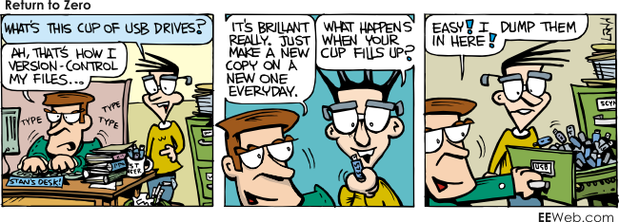

Slide 3
Managing Team Coding Projects
In large, fast-changing projects with many authors, it is often difficult to track changes or monitor progress using traditional means
Most people implement simple source control without realizing it by using Save As
ReadingAssignment_Version1
GroupProject_JohnDoeDraft
This approach poses several challenges since it only creates a single backup copy:
Accidental file overwriting or unintentional deletion
Excessive email communication about versions
Direct updates to production server that eliminate prior copies of code
Delays while waiting for team members to send updated versions

Slide 4
Defining Source Control
Source Control is a tool used to manage updates and track file development during projects with multiple authors who access a common server
Also known as Revision Control or Version Control
With source control, authors can:
Lock files while they work on them to prevent overwriting
Save updates to a server accessible by all team members
Track specific changes to files and directories by others
After files are uploaded and unlocked, team members can pull updated versions from the server with details about who updated the file, which lines of code changed, and why the file was altered

Slide 5
Benefits of Source Control
Organization & Communication
Consistent file names and directory structures
Streamlined communication of file changes
Monitoring & Accountability
Complete history of file evolution
Ability to review individual team members’ code remotely
Records of who made which change and when they made it
Development & Deployment
Increased confidence making decisions because of ability to revert files
Ability to deploy different versions of code on separate servers
Decreased chance of accidental deletion

Slide 6
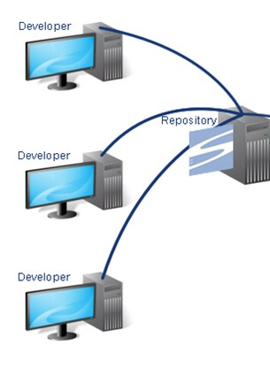
Repository
Source control saves changes using a repository, or a central store of data that tracks updates to files over the course of a project
The repository is stored on a server so that multiple individuals can access and update files on their own devices independently of other users
Stores information in the form of a file system tree, a navigable hierarchy of files and directories
A source control repository is different than a typical file server because it records all changes made as different versions branching from the initial upload

Slide 7
Monitoring Changes Using a Repository
Tracks each change behind the scenes so that you can view past file versions until ready to commit changes
Repositories can be created from scratch by importing new files using source control software or as updates to existing project by cloning previous repositories from hosts
Some changes tracked with a repository include:
Adding a new file
Moving files
Modifying a file (additions, deletions, revisions of specific components)
Removing a directory

Slide 8
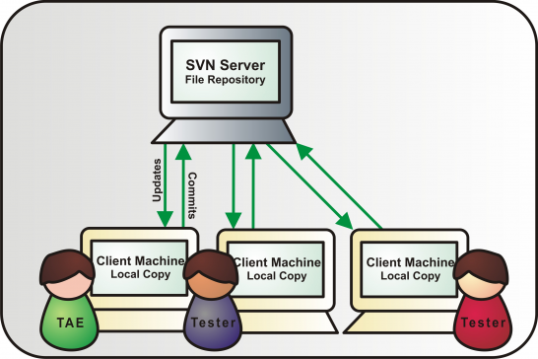
Committing Changes
Rather than tracking individual revisions line by line, source control stores updates as collection of actions called a commit
Clients download updates, make their own changes, then commit these updates to the server for others to view and modify
By tracking changes in groups, developers can link specific commits to emerging errors
Main set of committed files is referred to as the trunk or master

Slide 9
Revisions and Changesets
After a commit is made, the groups of changes included is recorded as a changeset
Changesets are given a unique revision number or hash (series of numbers or characters) to allow users to easily access old changesets to view past file versions
Changesets include:
Reference to who made the commit
Date and time committed
Files and directories affected
Actual changes to files
Lines numbers of code that changed
Comments explaining changes

Slide 10
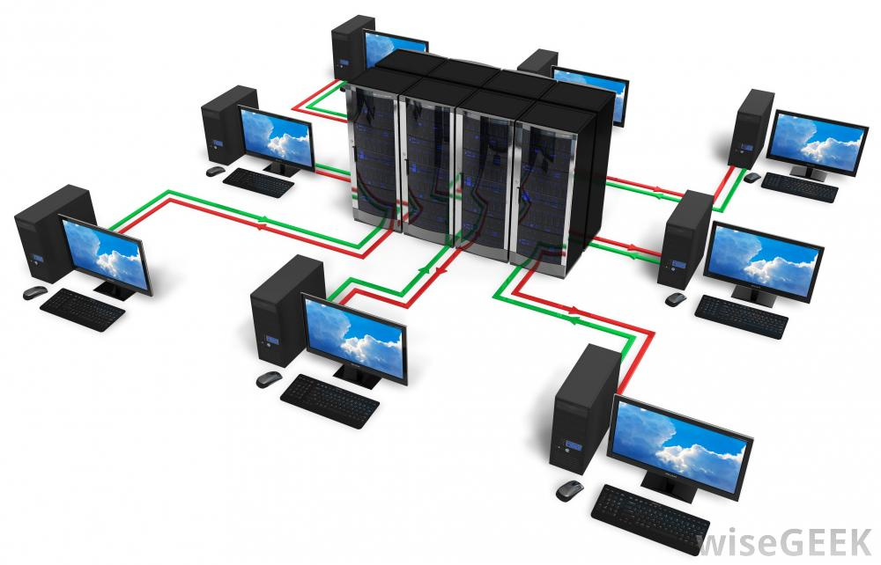
Pulling Updates from Server
Changes are saved on a hosted or centralized server
To receive most updated version of code, user requests a pull (an update) from server
Only changes since the user’s last pull are downloaded from server

Slide 11
Version Conflicts
Sometimes, overlapping editing can cause conflicts in file content
In most cases, algorithms behind source control systems can determine which edits are the authoritative, best changes to follow
In cases of conflict when team members make similar changes at same times, systems allow users to view differences between conflicting versions of code and select their preferred version
Users can edit files manually to merge different changes from a variety of changesets or can select one set to follow
It is helpful to collaborate with team members to determine which version is best to avoid future version conflicts
To avoid conflicts, users can lock files while they make updates

Slide 12
Diffing
Diffing, or viewing the difference between old versions, is a popular feature of source control software
Allows users to view what changed between revision sets
Compares two files or sets of files to see which lines of codes are different, who changed them, and when
Can compare sequentially or anywhere in history
Diffing is helpful for identifying causes of large errors because it allows users to isolate causes and identify when that problem emerged in the project history

Slide 13
Branching and Merging
If a user wants to experiment with changes, he can create a branch of the master which copies the repository to a separate location in the server’s memory
Can then modify entire project in parallel without altering the main set of files
Can also create branches off of branches, expanding version possibilities
This allows teams to simultaneously alter the master and its branches without affecting each other’s versions
Once experimental code is finalized, users merge their branch and the most recent version of the master
If the version control system cannot determine which change to apply during merging (if there is a significant code conflict between master and branch), a conflict arises, requiring manual intervention to decide which lines of code should remain

Slide 14
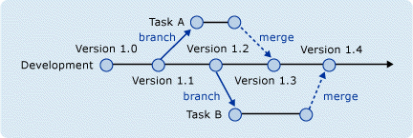
Branching and Merging

Slide 15
Types of Source Control Systems
Centralized Version Control
Client-Server relationship
Repository located in one place and can be accessed by many clients
Benefits:
Easy to understand and use
More control over access
More GUIs and IDEs
Drawbacks:
Dependent on server access
Must manage server and backup servers
Slower since every command must access server
More difficult to branch and merge
Example system: Subversion
Distributed Version Control
User has own copy of entire repository and histories on a personal server
Network of individual repositories
Benefits:
Fewer conflicts because of greater ability to track changes
Can commit changes offline since no central server is necessary
Faster, more reliable branching and merging
Drawbacks:
More difficult to understand
Newer, so fewer GUIs
Revisions do not have incremental numbers
Examples: Git, Mercurial

Slide 16
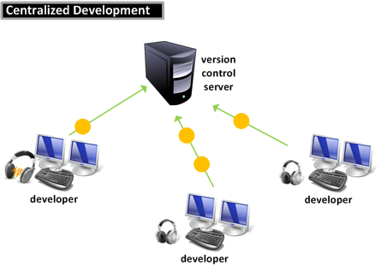

Slide 17
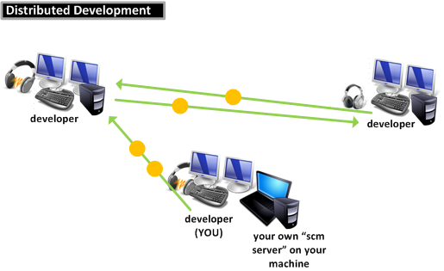
Note that all developers have their own servers with this system!

Slide 18
Source Control Best Practices
Code found solely on your machine is “ghost code”—no one else can see it!
Separate tasks into small pieces so that team members work on different sections of code simultaneously
Merge quickly and merge often—doing this prevents conflicts that are difficult to sift through
Always inspect changes before committing
Provide high quality explanations that both justify the reasons for your changes and the logic behind them

Slide 19
Common Terms
Repository: database that stores file versions
Server: Computer that hosts the repository
Client: Computer connecting to the repository
Working Copy: Local file directory downloaded to an individual computer
Trunk/Main: Primary location within the repository
Add: Upload a file to the repository for the first time to begin tracking
Get: Acquire a read-only version of a file in the repository
Update/Sync: Grab the latest version of all files from the server
Revision: Updated version of an added file
Head: Latest revision in the repository
Check Out: Download a file
Check In: Upload a revision and assign a revision number so others can check it out, send changes back to repository
Check in Message: Describes what changed in this version
Changelog/History: Lists changes made since file was initially created
Revert: Get rid of your local changes and reload head from repository
Locking: Preventing others from accessing the file while you edit it to avoid conflicts

Slide 20
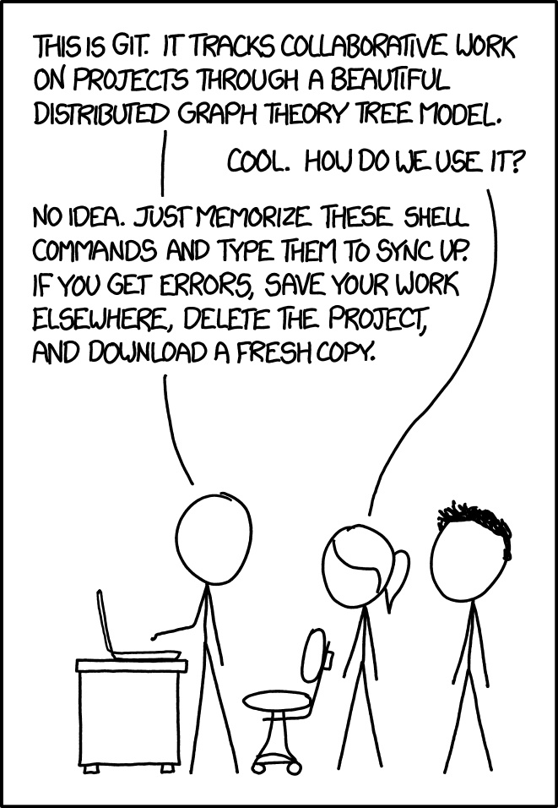
Git

Slide 21

git
Designed for code
What git does for you
Version control and source control
tracks all changes submitted to the codebase
revert changes
Create working braches without affecting stable releases
Tells you when there are merge conflicts
Why git?
Because “everyone” is using it
You’ll likely use it in industry

Slide 22
git
Version control software
Remote server hosts your repository
Every user maintains a local copy of the entire repository
Need to install git if it doesn’t come with your OS

Slide 23
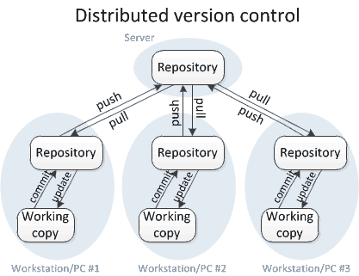
git is..

Slide 24
(some) git Commands
Make a repo
init
Update a repo
add
commit
push
Connect to and pull a remote repo
clone
Update local repo
pull

Slide 25
To Make a Repository
init
Creates a new git repo in the current directory
Or create a repo in GitHub and clone

Slide 26
Updating the Repo
add <filename>
Tell git that you want it to track <filename>
“add .” to add all files
commit
Updates changes to your local repository
Add a meaningful commit message
“git commit –am” to add and commit all modified files
.gitignore file

Slide 27
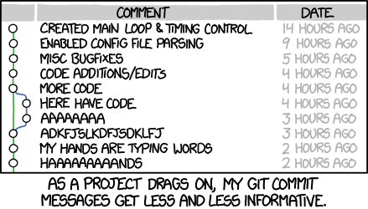
Commit messages
Many different conventions
Choose one
Or not
Whatever you do, make your messages meaningful and descriptive
Your future self and contributors will thank you!
Especially as you move on to bigger and better projects

Slide 28
Updating the Remote Repo
push
Updates the remote repo with the changes committed to your local repo
Lets your team access your changes
Will warn you to pull first if there are remote changes

Slide 29
Branching
More details can be seen here → https://www.youtube.com/watch?v=FyAAIHHClqI
git branch <branchName>
Creates a new branch
git checkout <branchName>
Switches the branch you are working with
git merge <branchName>
Would run from master or from the branch you are merging to
git branch –d <branchName>
Deletes the branch after the merge is complete

Slide 30
Other helpful commands
git log
git status
git diff

Slide 31
Connecting to a repo
clone <repoLocation>
Copies the entire repository to your local directory
https
git clone https://hartloff@bitbucket.org/hartloff/cse250-fall2015.git
ssh
git clone git@bitbucket.org:hartloff/cse250-fall2015.git
must create ssh keys and upload your public ssh key to the server

Slide 32
Pull often
pull
Copies the most up-to-date code from the server to your local copy of the repo
Can cause a merge conflict
pull often!

Slide 33

GitHub
Provides servers to host git repos
An interface and server for git
Why GitHub?
Because “everyone” uses it
It’s free

Slide 34
Questions?

